Slide 1
Secure Data Plane in K8s
HLD, Patterns, Use cases and Products review
Roger Carhuatocto
v1.2

Slide 2
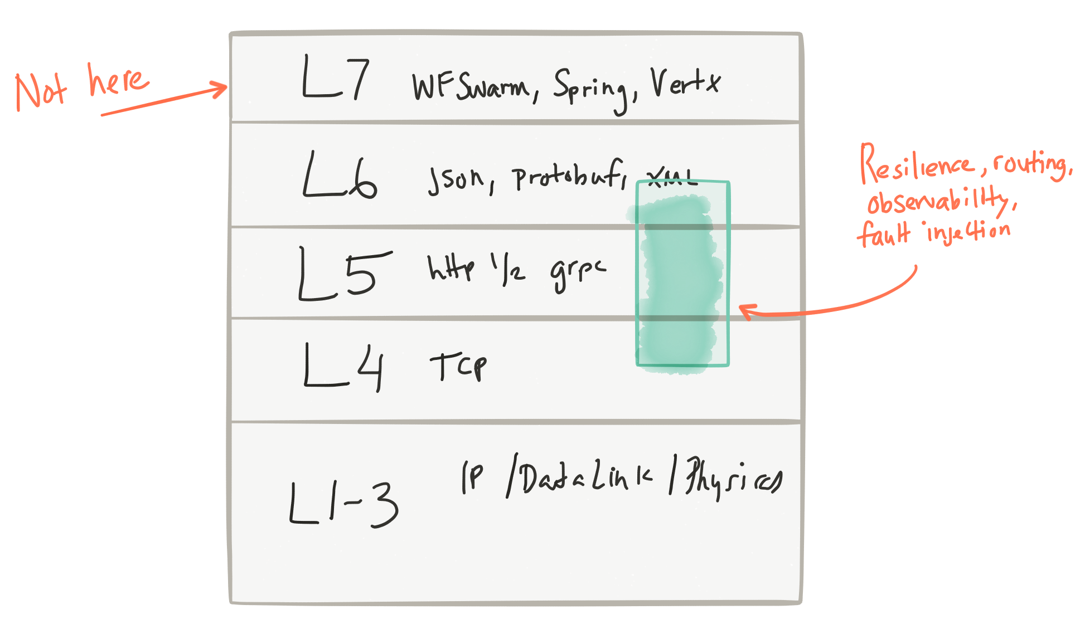
What is problem?
Build a Distributed System is a challenge.
How to expose my services?
How to call the services?
How to control the access to my services?
How to I know what is going on?
Traffic Management
Secure Data Plane
Pattern
Client
Proxy - Gateway “Mediation”
Backend
Client
Backend
Service discovery
Adaptive routing / client side load balancing
Automatic retries
Timeout controls
back pressure
Rate limiting
Metrics/stats collection
Tracing
A/B testing / traffic shaping / request shadowing
Service refactoring / request shadowing
Service deadline/timeout enforcement across service calls
Security between services
Edge gateway/router
Surgical / fine / per-request routing
Forced service isolation / outlier detection
Fault injection (ie, injecting delays? dropping ingress/egress packets?)
Internal releases/dark launches
Client
Backend
Client
Backend
http://blog.christianposta.com/microservices/the-hardest-part-of-microservices-calling-your-services

Slide 3
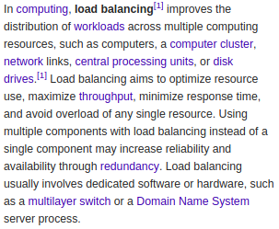
2. Definitions: Proxy, Load Balancer, Gateway, ...
Pattern
Client
Proxy - Gateway - Load Balancer
“Mediation”
Backend
Client
Backend
Client
Backend
Client
Backend
Features provided by LB/Proxy/Gw:
Service Discovery
Health Checking
Load Balancing
Sticky Sessions
TLS Termination
Observability
Security
Configuration (Control Plane)
https://en.wikipedia.org/wiki/Load_balancing_(computing)
https://en.wikipedia.org/wiki/Mediator_pattern
https://blog.envoyproxy.io/introduction-to-modern-network-load-balancing-and-proxying-a57f6ff80236

Slide 4
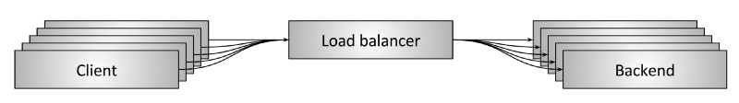
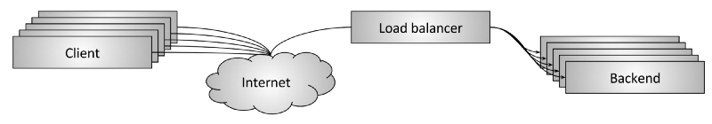
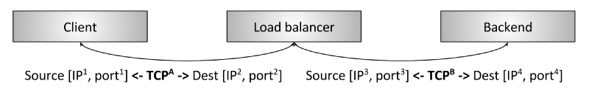
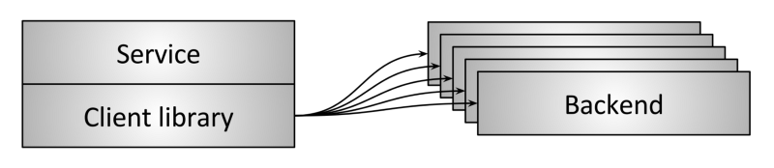
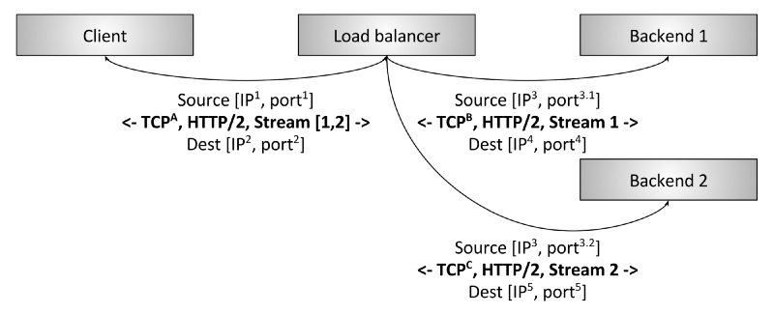
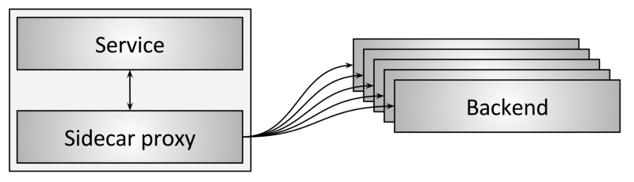
3. ...more
1
4
2
5
3
6
1) Proxy (LB)
2) L4 TCP LB
3) L4/L7 TCP LB
4) Edge Proxy (Edge LB)
5) Embedded Client Proxy Library
6) Sidecar Proxy
https://blog.envoyproxy.io/introduction-to-modern-network-load-balancing-and-proxying-a57f6ff80236

Slide 5

4. HLD: key components (1/2)
Kubernetes
1
Edge Proxy (LB)
Worker
4
Ingress Controller
Namespace
TLS/MTLS
Service
TLS/MTLS
TLS/MTLS
Proxy / Gw
TLS/MTLS
5
Pod
Pod
Pod
6
Sidecar
Host FW
East-West FW
localhost
2
3
Application
Container
L4/L7 FW
L4/L7 FW
VM
VM
VM
2
Host LB/FW
App
App
Monolith App
L4/L7 LB/FW
North-South Traffic
(in the node)
East-West Traffic
(between nodes)

Slide 6
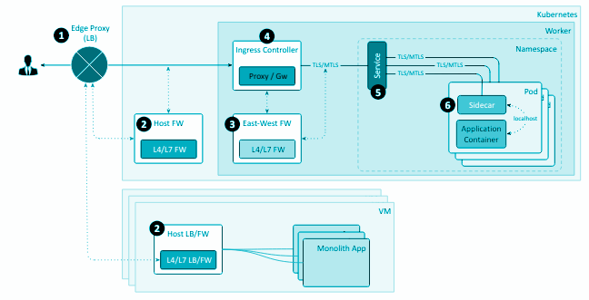
4. HLD: key components (2/2)
1. Edge Proxy (LB).
It’s the LB used for the Cloud Provider.
Some LB solutions are able to create a direct route towards the Pod by creating a K8s Service of type “Load Balancer”.
2. Host LB/FW.
Protects external facing Web Apps hosted in the Node from L4 to L7 Layers.
While WAF is focused in L7 Layer, a FW is in L4 to L7.
It can’t see the East-West Traffic (Docker Network Traffic), but would see North-South Traffic (Ingress Traffic).
3. East-West FW.
Protects all internal east-west traffic between containers while also including some of the protections of a WAF.
4. Ingress Controller.
Works as Reverse Proxy and adds Routing functionalities like to Edge Proxy (LB).
It sees the East-West Traffic between Containers while also including some of the protections of a WAF.
5. Service.
Abstraction for pods, providing a stable, virtual IP (VIP) address. Its purpose is purely to forward traffic to one or more pods.
6. Sidecar.
Contains all offloaded non-business features (security, logging, monitoring, throttling, policies, bootstrapping, etc.).
It is the last security link for the App Container and allows implement effective end-to-end security.

Slide 7
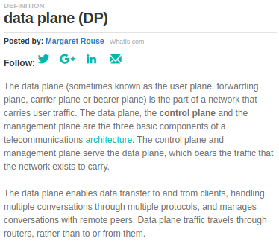
5. What is a Secure Data Plane?
The Secure Data Plane is the network of Pods connected through their Sidecars Containers.
Control Plane
Traffic Management
Policies
Observability
Metrics
Secure Data Plane
Sidecar
Sidecar
Sidecar
Sidecar
Sidecar
Sidecar
App
Container
App
Container
App
Container
App
Container
App
Container
App
Container
The Sidecar:
Contains all offloaded non-business features (security, logging, monitoring, throttling, policies, bootstrapping, etc.).
It is the last security link for the App Container and allows implement effective end-to-end security.
https://searchsdn.techtarget.com/definition/data-plane-DP

Slide 8
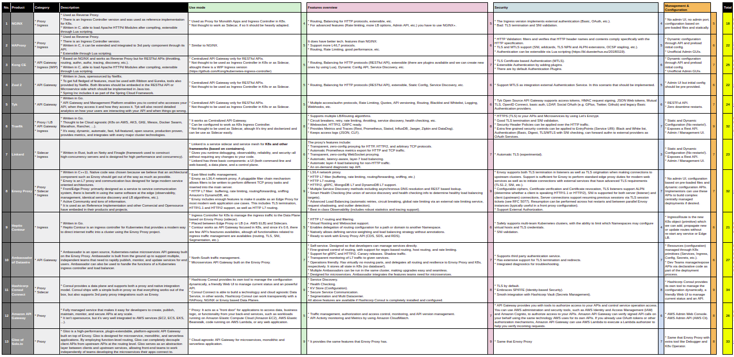
6. Load Balancer, Proxy, Gateway, Ingress & Sidecar
https://drive.google.com/open?id=1Ms0xtBiiDiv4IIswClQ1R0_Ua52AMxIFZJ7yMWPUOY0

Slide 9
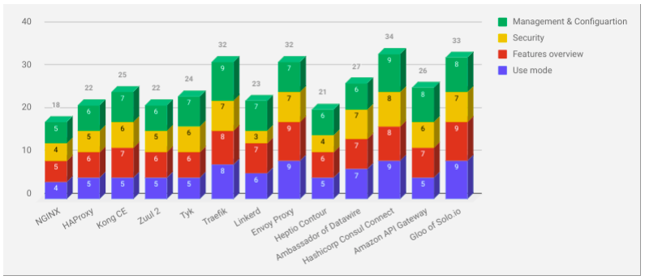
7. Load Balancer, Proxy, Gateway, Ingress & Sidecar
https://drive.google.com/open?id=1Ms0xtBiiDiv4IIswClQ1R0_Ua52AMxIFZJ7yMWPUOY0

Slide 10
8. Conclusions
It’s a Traffic Management problem with multiple weak links. The difficult is to adopt a multi-purpose tool to cover all gaps. Something like Hashicorp Consul (suite of tools) and/or like or compatible Envoy Proxy product (Istio, Gloo, Traefik, ...) is the right decision and solves:
How to expose our service?, for end clients (internet facing, other organizations, etc.), for developers, operational and security teams.
Other side the productivity, flexibility, scalability are important. With the right tools in place and adopting the best practices we will able to achieve them.
Ah!, why not open-source and avoid the vendor lock-in?

Slide 11
9. References
NGINX vs Traefik vs HAProxy (2018 May)
https://medium.com/@andreidascalu/nginx-vs-traefik-vs-haproxy-cc99546f676a
HAPROXY VS NGINX: WHICH SOFTWARE LOAD BALANCER IS BETTER? (2017 April)
https://www.freelancinggig.com/blog/2017/04/26/haproxy-vs-nginx-software-load-balancer-better
From Monolith to Service Mesh, via a Front Proxy — Learnings from stories of building the Envoy Proxy (2018 Sept)
https://itnext.io/from-monolith-to-service-mesh-via-a-front-proxy-learnings-from-stories-of-building-the-envoy-9dab4b721089
Microservice Proxy/Gateway Solutions / Service Mesh vs Reverse Proxy
https://gist.github.com/StevenACoffman/acf1133da6c5ff5226c0f6eb8fbd8132
HAProxy vs nginx: Why you should NEVER use nginx for load balancing!
https://thehftguy.com/2016/10/03/haproxy-vs-nginx-why-you-should-never-use-nginx-for-load-balancing
NGINX vs HAProxy — a bit like comparing a 2CV with a Tesla?
http://www.loadbalancer.org/blog/nginx-vs-haproxy
Service mesh data plane vs. control plane
https://blog.envoyproxy.io/service-mesh-data-plane-vs-control-plane-2774e720f7fc
Introduction to modern network load balancing and proxying
https://blog.envoyproxy.io/introduction-to-modern-network-load-balancing-and-proxying-a57f6ff80236
Cloud Design Patterns / Sidecar pattern
https://docs.microsoft.com/en-us/azure/architecture/patterns/sidecar
Comparing API Gateway Performances: NGINX vs. ZUUL vs. Spring Cloud Gateway vs. Linkerd
https://engineering.opsgenie.com/comparing-api-gateway-performances-nginx-vs-zuul-vs-spring-cloud-gateway-vs-linkerd-b2cc59c65369

